Slide 1
EE 319K
Introduction to Embedded Systems
Lecture 7: Phase-locked-loop,
Data structures,
Finite state machines, Interrupts
https://www.youtube.com/playlist?list=PLyg2vmIzGxXEle4_R2VA_J5uwTWktdWTu
Read Sections 4.3, 6.5, 9.1, and 9.2
Bard, Gerstlauer, Janapa Reddi, Telang, Tiwari, Valvano, Yerraballi

Slide 2
Agenda
Recap
  Indexed Addressing and Pointers
    In C: Address of (&), Pointer to (*)
  Data Structures: Arrays, Strings
    Length: hardcoded vs. embedded vs. sentinel
    Array access: indexed vs. pointer arithmetic
  Functional Debugging
  SysTick Timer
Outline
  Phase Lock Loop (PLL)
  Use struct to create Data structures
  Finite State Machines, Linked data structures
  Interrupts
Called by TExaS_Init
Bard, Gerstlauer, Janapa Reddi, Telang, Tiwari, Valvano, Yerraballi

Slide 3
Recap: Array access (assembly)
Calculate address from Base and index
  Byte Base+index
  Halfword Base+2*index
  Word Base+4*index
  Size_N Base+N*index
Access sequentially using pointers
  Byte pt = pt+1
  Halfword pt = pt+2
  Word pt = pt+4
  Size_N pt = pt+N
Bard, Gerstlauer, Janapa Reddi, Telang, Tiwari, Valvano, Yerraballi

Slide 4
Recap: Array access (C)
Calculate address from Base and index
  Byte array_name[index]
  Halfword array_name[index]
  Word array_name[index]
  Size_N array_name[index]
Access sequentially using pointers
  Byte pt = pt+1; *pt
  Halfword pt = pt+1; *pt
  Word pt = pt+1; *pt
  Size_N pt = pt+1; *pt
Bard, Gerstlauer, Janapa Reddi, Telang, Tiwari, Valvano, Yerraballi

Slide 5
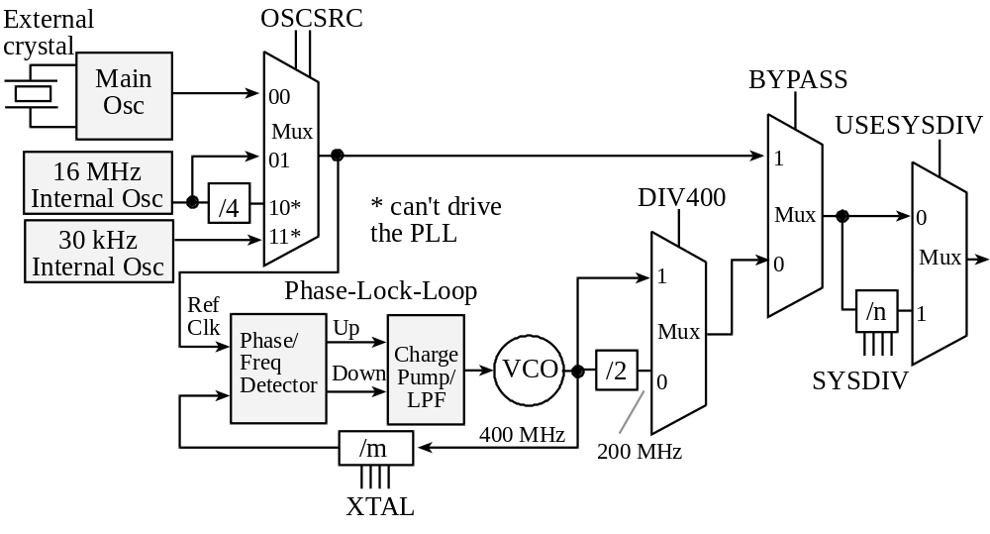
Phase-Lock-Loop
What?
Why?
How?
Internal oscillator requires minimal power but is imprecise
External crystal provides stable bus clock
TM4C123 is equipped with 16 MHz crystal and bus clock can be set to a maximum of 80 MHz
Bard, Gerstlauer, Janapa Reddi, Telang, Tiwari, Valvano, Yerraballi
Notes:
Example SYSDIV (n) values:
n=4 gives 400/(4+1) = 80 MHz
n=7 gives 400/(7+1) = 50MHz
n=9 gives 400/(9+1) = 40MHz
n=15 gives 400/(15+1) = 25MHz

Slide 6
Abstraction
Software abstraction
  Define a problem with a minimal set of basic, abstract principles / concepts
  Separation of concerns via interface/policy mechanisms
  Straightforward, mechanical path to implementation
Three advantages of abstraction are
  it can be faster to develop
  it is easier to debug (prove correct) and
  it is easier to change
Bard, Gerstlauer, Janapa Reddi, Telang, Tiwari, Valvano, Yerraballi

Slide 7
Finite State Machine (FSM)
Finite State Machines (FSMs)
  Set of inputs, outputs, states and transitions
  State graph defines input/output relationship
What is a state?
  Description of current conditions
What is a state graph?
  Graphical interconnection between states
What is a controller?
  Software that inputs, outputs, changes state
  Accesses the state graph
https://www.youtube.com/playlist?list=PLyg2vmIzGxXEle4_R2VA_J5uwTWktdWTu
Bard, Gerstlauer, Janapa Reddi, Telang, Tiwari, Valvano, Yerraballi

Slide 8
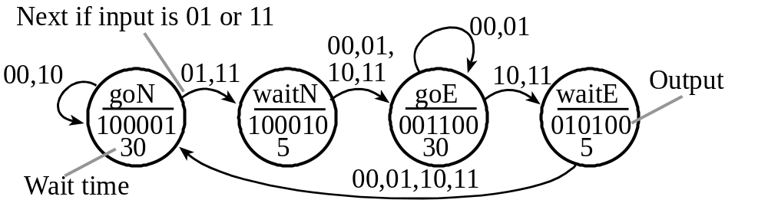
Finite State Machine (FSM)
What is a finite state machine?
  Inputs (sensors)
  Outputs (actuators)
  Controller
  State graph
Bard, Gerstlauer, Janapa Reddi, Telang, Tiwari, Valvano, Yerraballi

Slide 9
Finite State Machine (FSM)
Moore FSM
  output value depends only on the current state,
  inputs affect the state transitions
  significance is being in a state
Input: when to change state
Output: definition of being in that state
Bard, Gerstlauer, Janapa Reddi, Telang, Tiwari, Valvano, Yerraballi

Slide 10
Finite State Machine (FSM)
Moore FSM Execution Sequence
  Perform output corresponding to the current state
  Wait a prescribed amount of time (optional)
  Read inputs
  Change state, which depends on the input and the current state
  Go back to 1. and repeat
We will not do Mealy FSMs in EE319K
Bard, Gerstlauer, Janapa Reddi, Telang, Tiwari, Valvano, Yerraballi

Slide 11
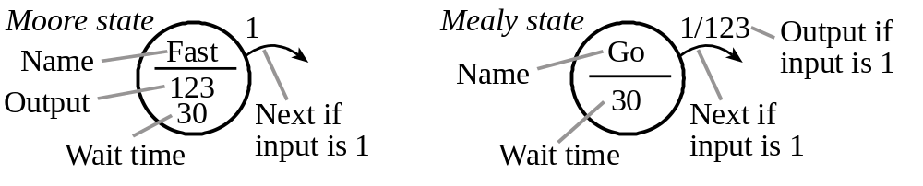
Finite State Machine (FSM)
Bard, Gerstlauer, Janapa Reddi, Telang, Tiwari, Valvano, Yerraballi

Slide 12
FSM Implementation
Data Structure embodies the FSM
  multiple identically-structured nodes
  statically-allocated fixed-size linked structures
  one-to-one mapping FSM state graph and linked structure
  one structure for each state
Linked Structure
  pointer (or link) to other nodes (define next states)
Table structure
  indices to other nodes (define next states)
Bard, Gerstlauer, Janapa Reddi, Telang, Tiwari, Valvano, Yerraballi

Slide 13
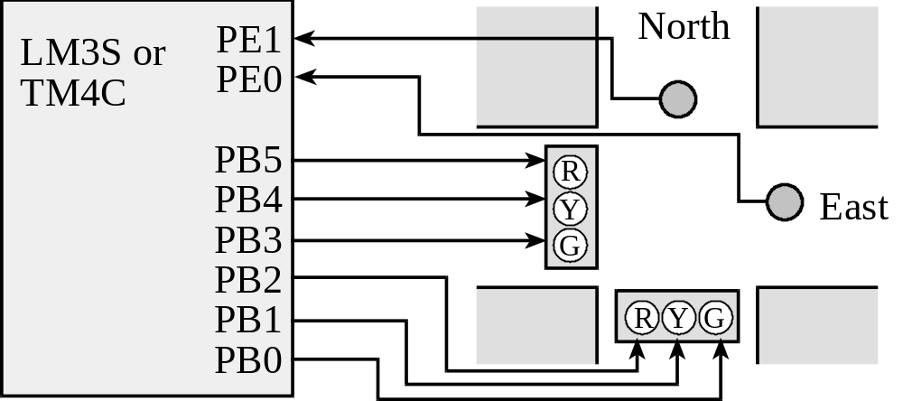
Traffic Light Control
PE1=0, PE0=0 means no cars exist on either road
PE1=0, PE0=1 means there are cars on the East road
PE1=1, PE0=0 means there are cars on the North road
PE1=1, PE0=1 means there are cars on both roads
goN, PB5-0 = 100001 makes it green on North and red on East
waitN, PB5-0 = 100010 makes it yellow on North and red on East
goE, PB5-0 = 001100 makes it red on North and green on East
waitE, PB5-0 = 010100 makes it red on North and yellow on East
http://users.ece.utexas.edu/~valvano/arm/C10_TableTrafficLight.zip
Bard, Gerstlauer, Valvano, Yerraballi

Slide 14
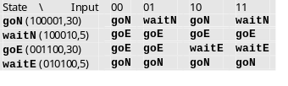
Traffic Light Control
http://youtu.be/kgABPjf9qLI
Bard, Gerstlauer, Janapa Reddi, Telang, Tiwari, Valvano, Yerraballi

Slide 15
Linked Data Structure
OUT EQU 0 ;offset for output
WAIT EQU 4 ;offset for time (10ms)
NEXT EQU 8 ;offset for next
goN DCD 0x21 ;North green, East red
DCD 3000 ;30 sec
DCD goN,waitN,goN,waitN
waitN DCD 0x22 ;North yellow, East red
DCD 500 ;5 sec
DCD goE,goE,goE,goE
goE DCD 0x0C ;North red, East green
DCD 3000 ;30 sec
DCD goE,goE,waitE,waitE
waitE DCD 0x14 ;North red, East yellow
DCD 500 ;5 sec
DCD goN,goN,goN,goN
In ROM
Bard, Gerstlauer, Janapa Reddi, Telang, Tiwari, Valvano, Yerraballi

Slide 16
FSM Engine (Moore)
; Port and timer initialization
LDR R4,=goN ; state pointer
LDR R5,=SENSOR ; PortE
LDR R6,=LIGHT ; PortB
FSM LDR R0,[R4,#OUT] ; 1.output value
STR R0,[R6] ; set lights
LDR R0,[R4,#WAIT] ; 2. time delay
BL SysTick_Wait10ms
LDR R0,[R5] ; 3. read input
LSL R0,R0,#2 ; offset(index):
; 4 bytes/address
ADD R0,R0,#NEXT ; 8,12,16,20
LDR R4,[R4,R0] ; 4. go to next state
B FSM
Bard, Gerstlauer, Janapa Reddi, Telang, Tiwari, Valvano, Yerraballi

Slide 17
FSM Data Structure in C (Indexes)
const struct State {
uint32_t Out;
uint32_t Time; // 10 ms units
uint32_t Next[4]; // list of next states
};
typedef const struct State STyp;
#define goN 0
#define waitN 1
#define goE 2
#define waitE 3
STyp FSM[4] = {
{0x21,3000,{goN,waitN,goN,waitN}},
{0x22, 500,{goE,goE,goE,goE}},
{0x0C,3000,{goE,goE,waitE,waitE}},
{0x14, 500,{goN,goN,goN,goN}}
};

Slide 18
FSM Engine in C (Indexes)
void main(void) {
uint32 CS; // index of current state
uint32_t Input;
// initialize ports and timer
…
CS = goN; // start state
while(1) {
LIGHT = FSM[CS].Out; // set lights
SysTick_Wait10ms(FSM[CS].Time);
Input = SENSOR; // read sensors
CS = FSM[CS].Next[Input];
}
}

Slide 19
FSM Data Structure in C (Pointers)
const struct State {
uint32_t Out;
uint32_t Time; // 10 ms units
const struct State *Next[4];
};
typedef const struct State STyp;
#define goN &FSM[0]
#define waitN &FSM[1]
#define goE &FSM[2]
#define waitE &FSM[3]
STyp FSM[4] = {
{0x21,3000,{goN,waitN,goN,waitN}},
{0x22, 500,{goE,goE,goE,goE}},
{0x0C,3000,{goE,goE,waitE,waitE}},
{0x14, 500,{goN,goN,goN,goN}}
};
Bard, Gerstlauer, Janapa Reddi, Telang, Tiwari, Valvano, Yerraballi

Slide 20
FSM Engine in C (Pointers)
void main(void) {
STyp *Pt; // state pointer
uint32_t Input;
// initialize ports and timer
…
Pt = goN; // start state
while(1) {
LIGHT = Pt->Out; // set lights
SysTick_Wait10ms(Pt->Time);
Input = SENSOR; // read sensors
Pt = Pt->Next[Input];
}
}
Bard, Gerstlauer, Janapa Reddi, Telang, Tiwari, Valvano, Yerraballi

Slide 21
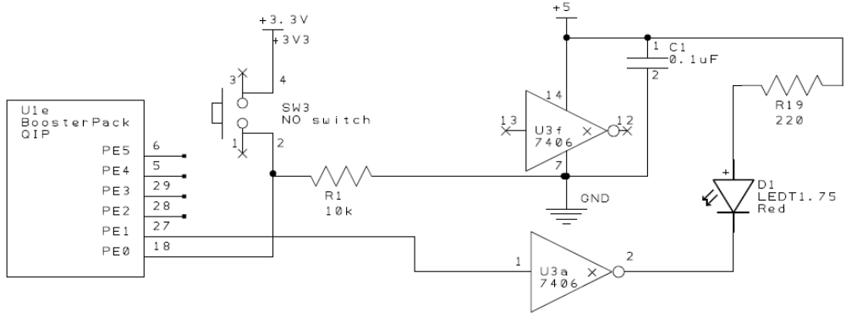
Thought Exercise: Implement Lab 3 as an FSM
2) The system starts with the LED on
3) Wait about 62 ms
4) If the switch is pressed ,then toggle the LED once, else turn the LED on.
5) Steps 3 and 4 are repeated over and over
Bard, Gerstlauer, Valvano, Yerraballi

Slide 22
State Transition Table
Num | Name | 6-LED | PF3-1 | Time | In=0 | In=1 | In=2 | In=3 | In=4 | In=5 | In=6 | In=7
0 | GoW | West green | Red
1 |  | West yellow | Red
2 |  | South green | Red
3 |  | South yellow | Red
4 |  | Both red | Green
5 |  | Both red | Red
6 |  | All red | off
Add more rows
Bard, Gerstlauer, Valvano, Yerraballi

Slide 23
Interrupts
An interrupt is the automatic transfer of software execution in response to a hardware event (trigger) that is asynchronous with current software execution.
  external I/O device (like a keyboard or printer) or
  an internal event (like an op code fault, or a periodic timer.)
Occurs when the hardware needs or can service (busy to done state transition)
Bard, Gerstlauer, Janapa Reddi, Telang, Tiwari, Valvano, Yerraballi

Slide 24
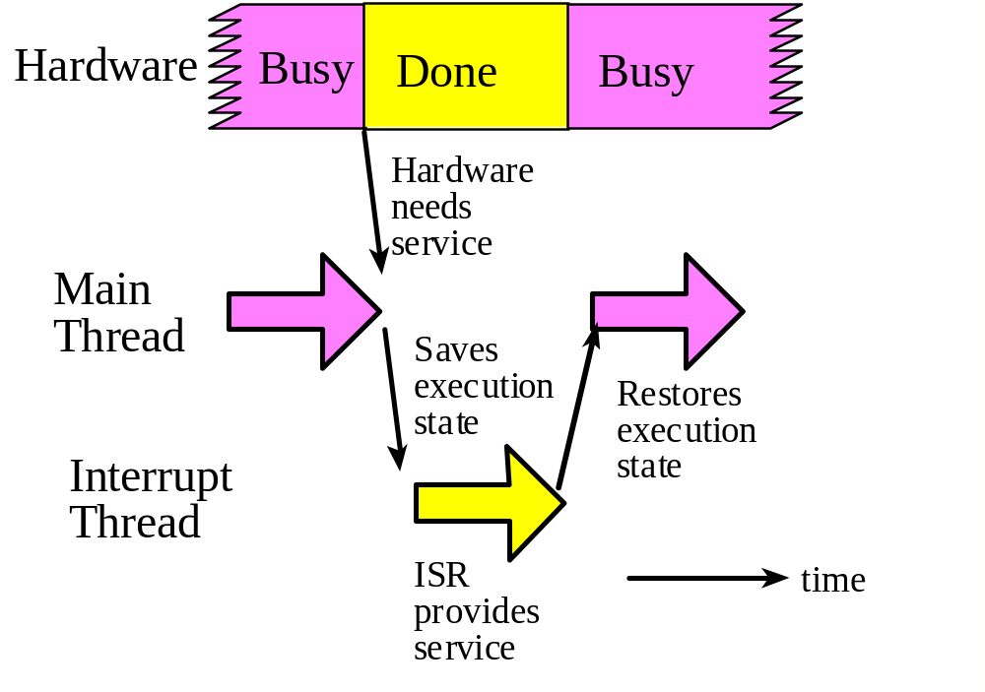
Interrupt Processing
Bard, Gerstlauer, Janapa Reddi, Telang, Tiwari, Valvano, Yerraballi

Slide 25
ARM Cortex-M Interrupts
Each potential interrupt source has a separate arm bit
  Set for those devices from which it wishes to accept interrupts,
  Deactivate in those devices from which interrupts are not allowed
Each potential interrupt source has a separate flag bit
  hardware sets the flag when it wishes to request an interrupt
  software clears the flag in ISR to signify it is processing the request
Interrupt enable conditions in processor
  Global interrupt enable bit, I, in PRIMASK register
  Priority level, BASEPRI, of allowed interrupts (0 = all)
Bard, Gerstlauer, Janapa Reddi, Telang, Tiwari, Valvano, Yerraballi

Slide 26
Interrupt Conditions
Four conditions must be true simultaneously for an interrupt to occur:
  Arm: control bit for each possible source is set
  Enable: interrupts globally enabled (I=0 in PRIMASK)
  Level: interrupt level must be less than BASEPRI
  Trigger: hardware action sets source-specific flag
Interrupt remains pending if trigger is set but any other condition is not true
  Interrupt serviced once all conditions become true
Need to acknowledge interrupt
  Clear trigger flag or will get endless interrupts!
Bard, Gerstlauer, Janapa Reddi, Telang, Tiwari, Valvano, Yerraballi

Slide 27
Interrupt Processing
The execution of the main program is suspended
  the current instruction is finished,
  suspend execution and push 8 registers (R0-R3, R12, LR, PC, PSR) on the stack
  LR set to 0xFFFFFFF9 (indicates interrupt return)
  IPSR set to interrupt number
  sets PC to ISR address
The interrupt service routine (ISR) is executed
  clears the flag that requested the interrupt
  performs necessary operations
  communicates using global variables
The main program is resumed when ISR executes BX LR
  pulls the 8 registers from the stack
Bard, Gerstlauer, Janapa Reddi, Telang, Tiwari, Valvano, Yerraballi

Slide 28
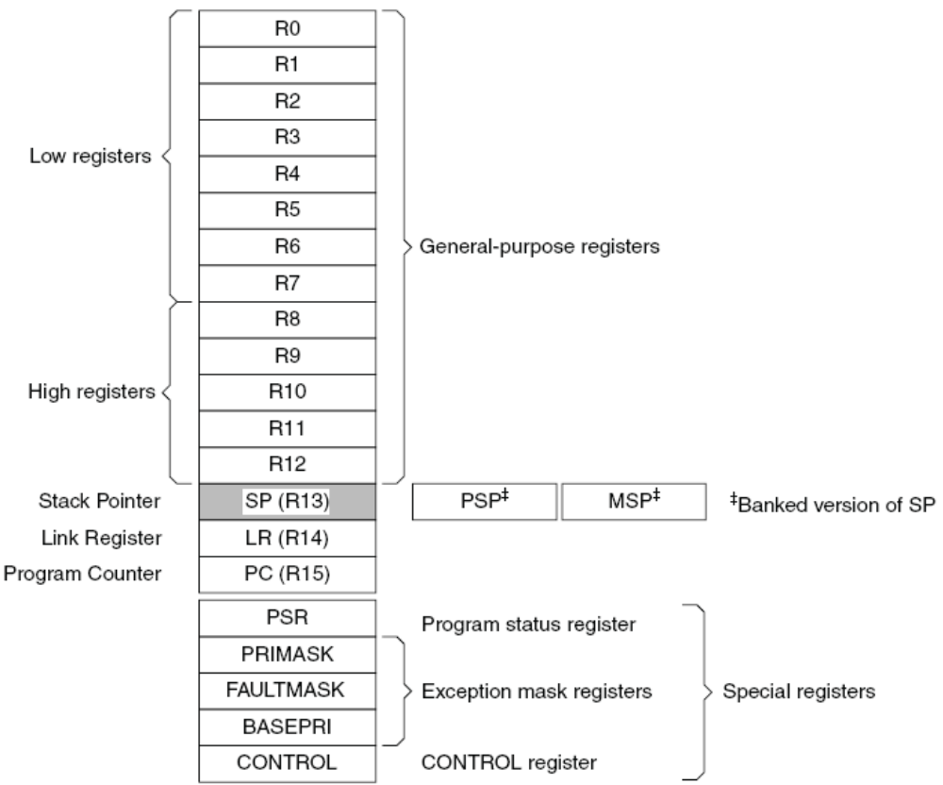
Registers
R0-R3 parameters
R4-R11 must be saved
R14, R15 are important
SP (R13) refers to PSP or MSP
We will use just the MSP
PRIMASK has intr. enable (I) bit
BASEPRI has allowed intr. priority
Bard, Gerstlauer, Janapa Reddi, Telang, Tiwari, Valvano, Yerraballi

Slide 29
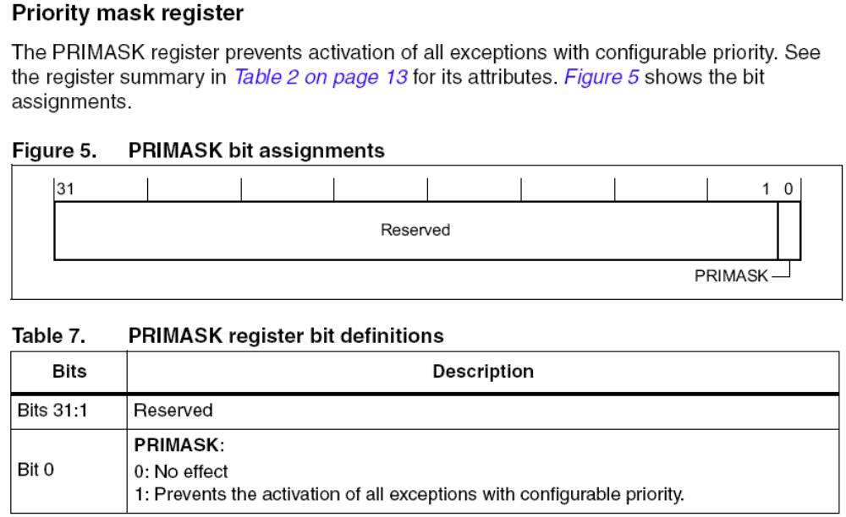
Priority Mask Register
Disable interrupts (I=1)
CPSID I
Enable interrupts (I=0)
CPSIE I
MRS R0,PRIMASK
CPSID I
MRS PRIMASK,R0
Interface latency
Bard, Gerstlauer, Janapa Reddi, Telang, Tiwari, Valvano, Yerraballi

Slide 30
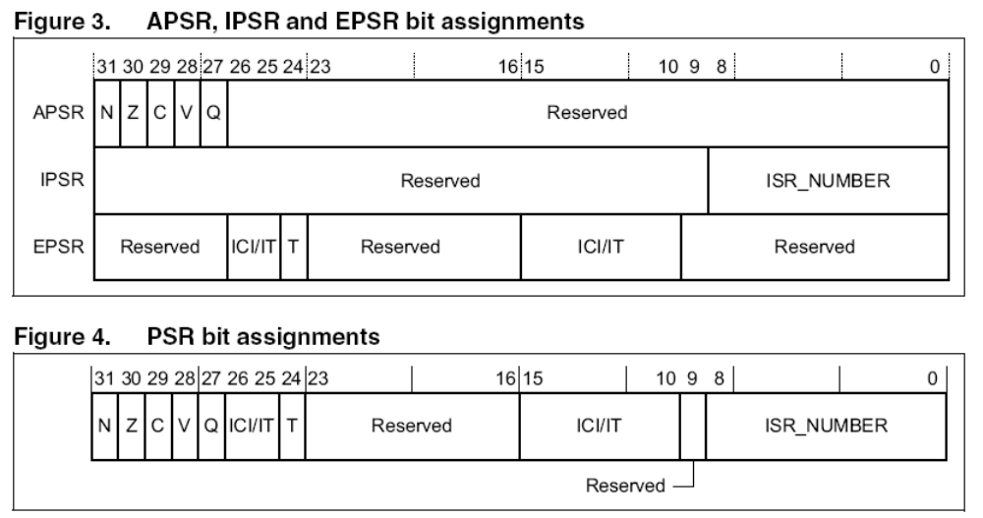
Program Status Register
Accessed separately or all at once
Q = Saturation, T = Thumb bit
Bard, Gerstlauer, Janapa Reddi, Telang, Tiwari, Valvano, Yerraballi

Slide 31
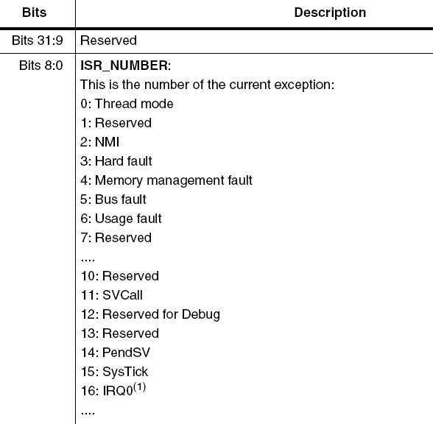
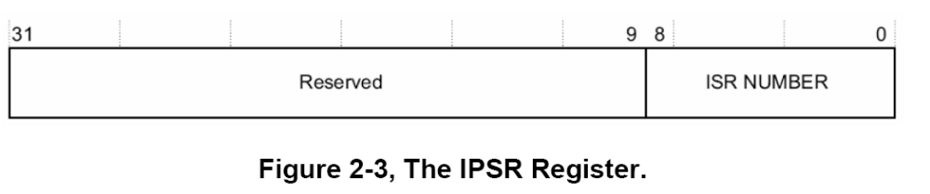
Interrupt Program Status Register (ISPR)
Run debugger: - stop in ISR and - look at IPSR
Bard, Gerstlauer, Janapa Reddi, Telang, Tiwari, Valvano, Yerraballi

Slide 32
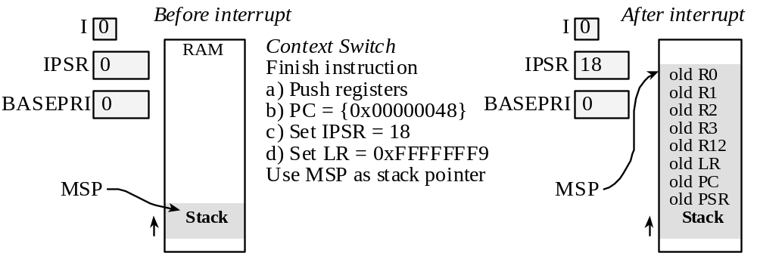
Interrupt Context Switch
Vector address for GPIO Port C
Interrupt Number 18 corresponds to GPIO Port C
Bard, Gerstlauer, Janapa Reddi, Telang, Tiwari, Valvano, Yerraballi

